Slide 1
Merge Sort Algorithm
Presented By S.R.Zameer

Slide 2
Merge Sort Algorithm
Merge Sort follows the rule of Divide and Conquer. But it doesn't divides the list into two halves. In merge sort the unsorted list is divided into N sublists, each having one element, because a list of one element is considered sorted. Then, it repeatedly merge these sublists, to produce new sorted sublists, and at lasts one sorted list is produced.

Slide 3
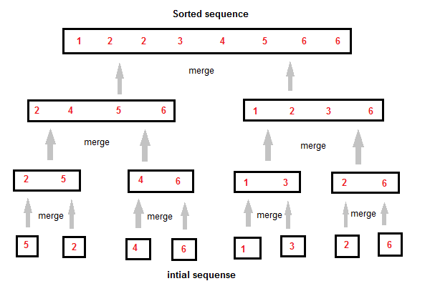
How Merge Sort Works

